Slide 2
Software testing
department INTEC
research group IBCN
Software Development & Operations

Slide 3
Overview
Development testing
Test-driven development
Behavior-driven development
Release testing
User testing

Slide 4
Program testing
Intended to show that a program does what it is intended to do and to discover program defects before it is put into use
When you test software, you execute a program using artificial data
You check the results of the test run for errors, anomalies or information about the program’s non-functional attributes
Can reveal the presence of errors NOT their absence

Slide 5
Program testing goals
Validation testing: to demonstrate to the developer and the customer that the software meets its requirements
For custom software: at least one test for every requirement in the requirements document
For generic software: tests for all of the system features, plus combinations of these features, that will be incorporated in the product release
Defect testing: to discover situations in which the behavior of the software is incorrect, undesirable or does not conform to its specification
Concerned with rooting out undesirable system behavior such as system crashes, unwanted interactions with other systems, incorrect computations and data corruption
The test cases in defect testing can be deliberately obscure and need not reflect how the system is normally used

Slide 6
Input-output model of program testing

Slide 7
Inspections and testing
Software inspections
Concerned with analysis of the static system representation to discover problems (static verification)
May be supplemented by tool-based document and code analysis
Software testing
Concerned with exercising and observing product behavior (dynamic verification)
The system is executed with test data and its operational behavior is observed.

Slide 8
Software inspections
These involve people examining the source representation with the aim of discovering anomalies and defects
Inspections do not require execution of a system so may be used before implementation
May be applied to any representation of the system (requirements, design, configuration data, test data, etc.)
Have been shown to be an effective technique for discovering program errors
Benefits
During testing, errors can mask (hide) other errors
Because inspection is a static process, you don’t have to be concerned with interactions between errors
Incomplete versions of a system can be inspected without additional costs
If a program is incomplete, then you need to develop specialized test harnesses to test the parts that are available
As well as searching for program defects, an inspection can also consider broader quality attributes of a program, such as compliance with standards, portability and maintainability

Slide 9
Inspections and testing
Inspections and testing are complementary and not opposing verification techniques
Both should be used
Inspections can check conformance with a specification but not conformance with the customer’s real requirements
Inspections cannot check non-functional characteristics such as performance, usability, etc.

Slide 10
White box vs black box testing
When designing tests you can use knowledge about the internals of the tested system, or you can choose to not do so
White box/clear box/open box/glass box testing sees the tester using knowledge about system internals e.g. by looking at code
Black box testing sees the tester look if the software functionally does what is expected, without any knowledge about the internals

Slide 11
Code coverage
Code coverage is a name for different measurements dealing with percentage of code that is tested
Statement coverage: percentage of statements in source code that is executed during testing
Select tools can calculate this percentage, and visualize which statements are not executed yet
Statement coverage of 100% means every statement in the source code has been tested at least once
Note: 100% statement coverage does not mean everything is tested
If(a>18) System.out.println(“adult”);
If a == 20 all statements in this fragment are executed
But condition can also be false, this also requires testing
Use multiple tests (which hopefully test a==18 which the system falsely does not label as adult)

Slide 12
Decision and loop coverage
To test an if-statement you write at least 2 tests
One where the decision evaluates to true
One where it evaluates to false
Same for if-else statements and for loops: while, for, do-while
Important to test border values
E.g. (if a > 18) System.out.println(“adult”)
Should be tested for values a = 17, 18, 19

Slide 13
Development testing

Slide 14
Development testing
Development testing includes all testing activities that are carried out by the team developing the system
Unit testing, where individual program units / object classes are tested
Focus on testing the functionality of objects or methods
Component testing, where several individual units are integrated to create composite components
Focus on testing component interfaces
System testing, where some or all of the components in a system are integrated and the system is tested as a whole
Focus on testing component interactions

Slide 15
Automated testing
Whenever possible, unit testing should be automated so that tests are run and checked without manual intervention
In automated unit testing, you make use of a test automation framework (such as JUnit) to write and run your program tests
Unit testing frameworks provide generic test classes that you extend to create specific test cases
Can run all of the tests that you have implemented and report, often through some GUI, on the success or failure of the tests
Tests consist of
A setup part, where you initialize the system with the test case, namely the inputs and expected outputs
A call part, where you call the object or method to be tested
An assertion part where the result of the call is compared to the expected result

Slide 16
Choosing Unit test cases
The test cases should show that, when used as expected, the component that you are testing does what it is supposed to do
If there are defects in the component, these should be revealed by test cases
This leads to 2 types of unit test case
The first should reflect normal operation of a program and should show that the component works as expected
The other kind of test case should be based on testing experience of where common problems arise. It should use abnormal inputs to check that these are properly processed and do not crash the component.

Slide 17
Testing strategies
Partition testing, where you identify groups of inputs that have common characteristics and should be processed in the same way
Input data and output results often fall into different classes where all members of a class are related
Each of these classes is an equivalence partition where the program behaves in an equivalent way for each class member
Test cases should be chosen from each partition
Guideline-based testing, where you use testing guidelines to choose test cases
These guidelines reflect previous experience of the kinds of errors that programmers often make when developing components

Slide 18
Equivalence partitioning

Slide 19
Equivalence partitions

Slide 20
Testing guidelines
Sequences
Test software with sequences which have only a single value
Use sequences of different sizes in different tests
Derive tests so that the first, middle and last elements of the sequence are accessed
Test with sequences of zero length
General
Choose inputs that force the system to generate all error messages
Design inputs that cause input buffers to overflow
Repeat the same input or series of inputs numerous times

Slide 21
Testing policies
Exhaustive system testing is impossible so testing policies which define the required system test coverage may be developed
Examples of testing policies
All system functions that are accessed through menus should be tested
Combinations of functions (e.g. text formatting) that are accessed through the same menu must be tested
Where user input is provided, all functions must be tested with both correct and incorrect input

Slide 22
Test-driven development

Slide 23
Test-driven development
Test-driven development (TDD) is an approach to program development in which you inter-leave testing and code development
Tests are written before code and ‘passing’ the tests is the critical driver of development
You develop code incrementally, along with a test for that increment
You don’t move on to the next increment until the code that you have developed passes its test
TDD was introduced as part of agile methods such as Extreme Programming
Can also be used in plan-driven development processes

Slide 24
TDD process activities
Start by identifying the increment of functionality that is required
Should normally be small and implementable in a few lines of code
Write a test for this functionality and implement this as an automated test
Run the test, along with all other tests that have been implemented
Initially, you have not implemented the functionality so the new test will fail
Implement the functionality and re-run the test
Once all tests run successfully, you move on to implementing the next chunk of functionality

Slide 25
Benefits of test-driven development
Code coverage
Every code segment that you write has at least one associated test so all code written has at least one test
Regression testing
A regression test suite is developed incrementally as a program is developed
Simplified debugging
When a test fails, it should be obvious where the problem lies - newly written code needs to be checked and modified
System documentation
The tests themselves are a form of documentation that describe what the code should be doing

Slide 26
Regression testing
Regression testing is testing the system to check that changes have not ‘broken’ previously working code
In a manual testing process, regression testing is expensive but, with automated testing, it is simple and straightforward
All tests are rerun every time a change is made to the program
Tests must run ‘successfully’ before the change is committed

Slide 27
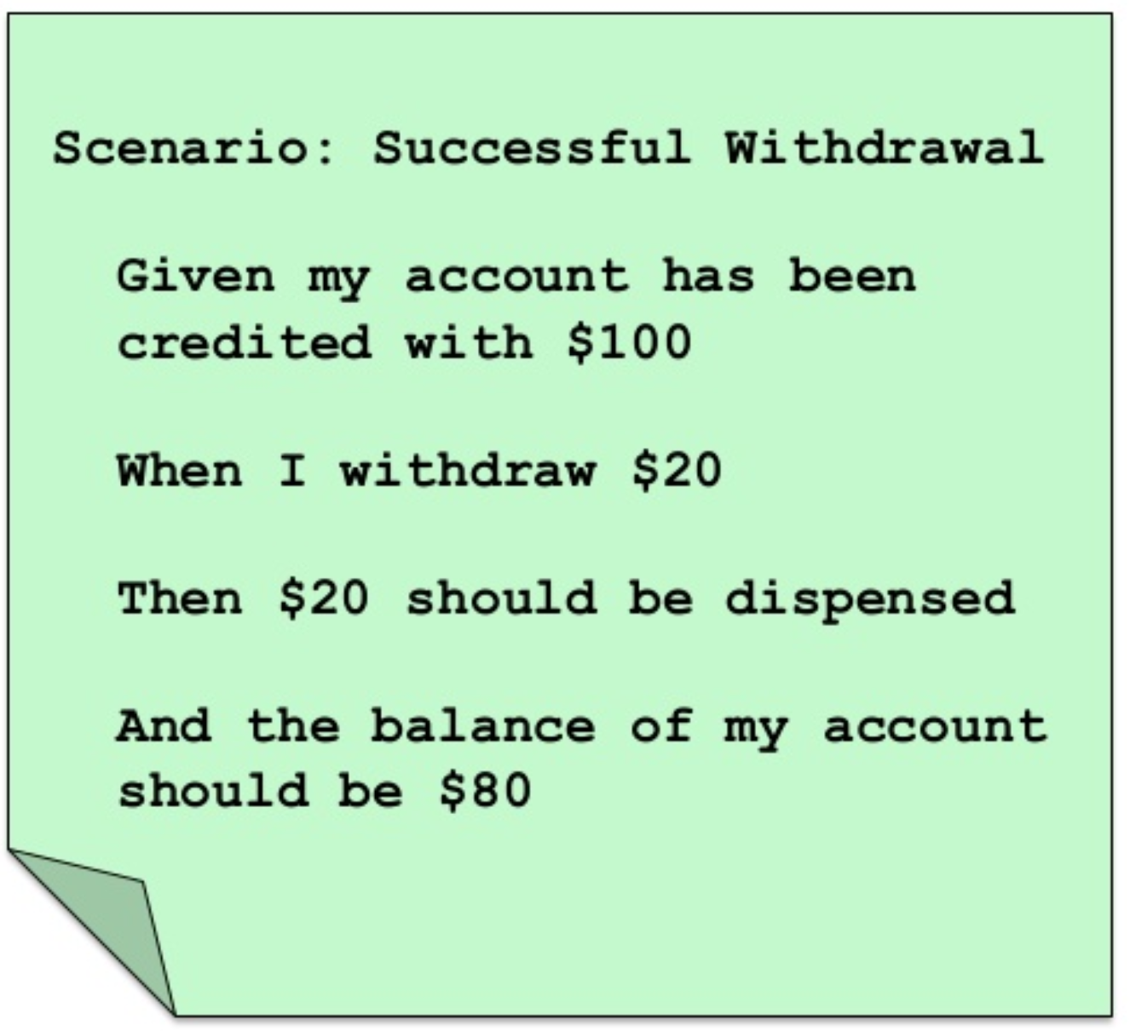
Behavior driven development
Emerged from Test-Driven Development
BDD practitioners collaborate to define detailed acceptance criteria before developing application code
Turn the criteria into executable acceptance tests (again before developing app code)
Watch tests fail
Pass tests when application functionality is implemented

Slide 28
Behavior versus Test driven development
Focus is different
BDD focusses on the building the right thing (business value)
TDD focusses on building the thing right (technical quality)
Granularity is different
BDD scope is business functionality
TDD scope is software class and unit level
Participants differ
BDD: greater variety of participants
TDD is developer centric
Specification languages differ
BDD test specifications are in business language (e.g. Cucumber’s Gherkin)
TDD test specifications are in programmer focused unit testing language (e.g. JUnit)

Slide 29
Release and user testing

Slide 30
Release testing
Release testing is the process of testing a particular release of a system that is intended for use outside of the development team
Primary goal: to convince the supplier of the system that it is good enough for use
Has to show that the system delivers its specified functionality, performance and dependability, and that it does not fail during normal use
Release testing is usually a black-box testing process where tests are derived from the system specification

Slide 31
Release testing and system testing
Release testing is a form of system testing
Important differences
A separate team that has not been involved in the system development, should be responsible for release testing
System testing by the development team should focus on discovering bugs in the system (defect testing)
The objective of release testing is to check that the system meets its requirements and is good enough for external use (validation testing)

Slide 32
Requirements-based testing
Requirements-based testing involves examining each requirement and developing a test or tests for it
MHC-PMS requirements
If a patient is known to be allergic to any particular medication, then prescription of that medication shall result in a warning message being issued to the system user
If a prescriber chooses to ignore an allergy warning, they shall provide a reason why this has been ignored

Slide 33
MHC-PMS Requirements tests
EXAMPLE
Set up a patient record with no known allergies. Prescribe medication for allergies that are known to exist. Check that a warning message is not issued by the system.
Set up a patient record with a known allergy. Prescribe the medication to that the patient is allergic to, and check that the warning is issued by the system.
Set up a patient record in which allergies to two or more drugs are recorded. Prescribe both of these drugs separately and check that the correct warning for each drug is issued.
Prescribe two drugs that the patient is allergic to. Check that two warnings are correctly issued.
Prescribe a drug that issues a warning and overrule that warning. Check that the system requires the user to provide information explaining why the warning was overruled.

Slide 34
Performance testing
Part of release testing may involve testing the emergent properties of a system, such as performance and reliability
Tests should reflect the profile of use of the system
Performance tests usually involve planning a series of tests where the load is steadily increased until the system performance becomes unacceptable
Stress testing is a form of performance testing where the system is deliberately overloaded to test its failure behavior

Slide 35
User testing
User or customer testing is a stage in the testing process in which users or customers provide input and advice on system testing
User testing is essential, even when comprehensive system and release testing have been carried out
Influences from the user’s working environment have a major effect on the reliability, performance, usability and robustness of a system
These cannot be replicated in a testing environment

Slide 36
Types of user testing
Alpha testing
Users of the software work with the development team to test the software at the developer’s site
Beta testing
A release of the software is made available to users to allow them to experiment and to raise problems that they discover with the system developers
Acceptance testing
Customers test a system to decide whether or not it is ready to be accepted from the system developers and deployed in the customer environment
Primarily for custom systems

Slide 37
Key points

Slide 38
Key points
Testing can only show the presence of errors in a program
Cannot demonstrate that there are no remaining faults
Development testing is the responsibility of the software development team. A separate team should be responsible for testing a system before it is released to customers.
Development testing includes
Unit testing: test individual objects and methods
Component testing: test related groups of objects
System testing: test partial or complete systems

Slide 39
Key points
When testing software, you should try to ‘break’ the software by using experience and guidelines to choose types of test case that have been effective in discovering defects in other systems
Wherever possible, you should write automated tests. The tests are embedded in a program that can be run every time a change is made to a system.
Test-first development is an approach to development where tests are written before the code to be tested
Behavior-driven development focusses on testing business functionality

